Slide 1

ECE 382V: QUANTUM COMPUTING SYSTEMS:
A SOFTWARE/ ARCHITECTURE PERSPECTIVE
SUPERPOSITION & ENTANGLEMENT
Why quantum computing? What topics will be covered? What are the requirements and expected outcomes?
POULAMI DAS
ECE, The University of Texas at Austin

Slide 2
Quantum Systems Are Exponentially Powerful
400 particles ➔ 2⁴⁰⁰ Steps each cycle
>> Number of particles in the universe (~ 2²⁵⁰ )
>> Age of the universe in nanoseconds (~ 2⁹⁰ )
X
N particles
[Example from Vazirani, UCB]
How do quantum computers get their exponential computational power?
Notes:
Lets try to understand what we mean when we say quantum systems are exponentially powerful. Let’s say we have a small quantum system with few hundred particles (electrons or photons). Say, a system of 400 particles.
<click>
Then, if we could harness all the computation power inherent in the system as promised by quantum mechanics, then each cycle we could potentially carry out exponential in 400, so 2 to the power of 400 steps in each cycle.
<click>
How big is 2-to-the-400? It is much larger than the particles of the universe (X). It is much larger than the age of the universe in femto seconds (Y). In fact it is much larger than the product of the these two quantities.
<click>
What this means is that if we could harness this computation power, there is no way that in the classical universe we could match that even if we were able to use the entire resources of the universe.
However, harnessing this power is very difficult and not all applications are suitable for this.
Superposition is one of the key property that enables this exponential power. In this lecture, we will learn about superposition.

Slide 3
Bits And Operations In Classical Domain
Classical Bit
State-0
100%
0%
State-0
0%
100%
or
State-1
State-1
On
A system with 2 bits
(b₂,b₁)
0 or 1
State-00
0%
0%
State-00
0%
100%
Off
State-01
State-01
State-10
100%
0%
State-10
0%
0%
State-11
State-11
Deterministic State
Classical bits and operations correspond to deterministic states
Notes:
The fundamental unit of information in the conventional computers is a bit. <click> A bit can be in either an ON state or the OFF state. The ON state being the “1” state and the OFF state being the “0” state. Computation is performed with gates that can manipulate the state of the bit.
<click>
You could plot the state of the bit as a probability distribution over the state 0 and state 1. At any time, the qubit will either be in state 0, with hundred probability 100% or in state-1 with 100% probability.
<click>
In fact, if we have a system with 2 bits, then there are four possible states, 00 01 10 and 11. Even though the set of bits could have any of the four possible values, at any time they can represent ONE AND ONLY ONE value – for example, here the bits are in state 10 and when we observe the bits we expect to get 10 with 100% probability.
<click>
When we operate on the bits, say applying NOT gates on the collection of bits, then we change the state which will appear with 100% probability <click> for example that state is now 01.
Thus, a bit or collection of bits have a deterministic value at any time, and by doing logic operations we go from one deterministic state to another deterministic state.

Slide 4
Bits And Operations In Quantum Domain
Quantum Bit (Qubit)
State-0
50%
50%
75%
25%
10%
90%
or
or
State-1
State-0
+
A system with 2 qubits
(q₂,q₁)
State-00
8%
17%
X-Gate
State-00
50%
25%
State-1
State-01
State-01
State-10
25%
50%
State-10
17%
8%
Superposition State
State-11
State-11
Quantum states and operations correspond to superposition states
Notes:
The fundamental unit of information in a quantum computer is a quantum bit or qubit. Rather than being restricted to only a 0 or a 1 state, the qubit can simultaneously be in a superposition of both the states.
<click>
You could plot the state of the qubit as a probability distribution over the state 0 and state 1. A qubit could be in state-0 and state-1 with equal probability, or with 75/25 probability, or 10/90 or any degree of superposition between state-0 and state-1.
<click>
Similarly, if we have a system with two qubits, then we could have four possible states 00, 01, 10, and 11. And the qubits could be in the state of superposition of any of these four states. For example, it could have the distribution as shown here with state-11 with 50% probability, and the other three states with 25%, 17%, and 8% probability.
<click>
When we operate on the qubits with quantum operations, such as the X gates which are the quantum equivalent of the NOT gate, then we change the probability distribution of the qubits. For example, inverting the qubits inverts the probability distribution across the four states.

Slide 5
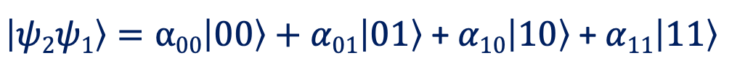
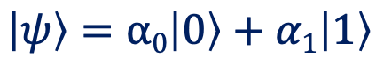








Qubit Representation Using Complex Vectors
Bra-ket notation or the Dirac notation
Qubit Notations
Single-Qubit Notation
$$\left|ψ\right\rangle =α0\left|0\right\rangle +α1\left|1\right\rangle$$
$$\left|0\right\rangle$$
❘⍺₀❘²
❘⍺₁❘²
$$\left|0\right\rangle$$
$$\left|1\right\rangle$$
Multi-Qubit Notation
$$\left|00\right\rangle$$
❘⍺₀₀❘²
❘⍺₀₁❘²
$$\left|1\right\rangle$$
$\left|ψ2ψ1\right\rangle =α00\left|00\right\rangle +α01\left|01\right\rangle$ + $α10\left|10\right\rangle$ + $α11\left|11\right\rangle$
$$\left|01\right\rangle$$
$$\left|10\right\rangle$$
❘⍺₁₀❘²
❘⍺₁₁❘²
$$\left|11\right\rangle$$
A system with N qubits can simultaneously exist in 2^{N} states
Notes:
The state of the qubit is typically specified by what is called as the DIRAC notation. The states 0 and 1 are represented as a column vector Ket-0 and Ket-1.
The qubit Psi is represented as a sum of alpha-zero ket-zero plus alpha-1 ket-1. Where alpha-0 and alpha-1 are probability amplitude associated with state-0 and state-1. When measured, the qubit will be state 0 with a probability alpha-0-square and in state-1 with probability alpha-1 square.
<click>
Similarly, for a system with two qubits, there are four states ket-00, ket-01, ket-10, and ket-11, and there are four coefficients providing the probabability amplitude associated with each state. When measured, the qubit will collapse to one of the state that is equal to the square of probability magnitude of the associated state.
Thus, …

Slide 6
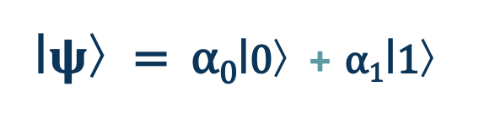
Effect Of Qubit Measurement
Measurement collapses a qubit into one of its basis states
❘0〉
with probability
❘⍺₀❘²
❘ $ψ$〉= ⍺₀❘0〉+ ⍺₁❘1〉
❘1〉
with probability
❘⍺₁❘²
Superposition is lost after measurement operation
Measuring N qubits produce an N-bit classical outcome
Notes:
The state of the qubit is typically specified by what is called as the DIRAC notation. The states 0 and 1 are represented as a column vector Ket-0 and Ket-1.
The qubit Psi is represented as a sum of alpha-zero ket-zero plus alpha-1 ket-1. Where alpha-0 and alpha-1 are probability amplitude associated with state-0 and state-1. When measured, the qubit will be state 0 with a probability alpha-0-square and in state-1 with probability alpha-1 square.
<click>
Similarly, for a system with two qubits, there are four states ket-00, ket-01, ket-10, and ket-11, and there are four coefficients providing the probabability amplitude associated with each state. When measured, the qubit will collapse to one of the state that is equal to the square of probability magnitude of the associated state.
Thus, …

Slide 7
A Simple Qubit: State Of An Electron
Excited
State |1>
Ground state ➔ ❘0〉 Excited state ➔ ❘1〉
Ground
State |0>
Ground state with prob 75%, excited state with prob 25%
Nucleus
Complex amplitude for defining probabilities:
Electron in an atom
⍺₀❘0〉+ ⍺₁❘1〉where ❘⍺₀❘²+ ❘⍺₁❘² = 1
What are the other potential implementations of a qubit?
Notes:
Just like there are many ways to physically realize the classical bit, we can have two voltage levels with an on-off transistor or vacuum tube, there are many different technologies to realize a qubit -- you can use photons, or superconductors, or ions.
Lets suppose we want to represent the qubit as a state of an electron. The energy of an electron is quantized. Let’s say we have a hydrogen atom, then the electron is allowed to be in either the ground state or in the excited state.
<click>
We could encode the bit as ground state is state 0 and excited state is 1
<click>
The electron in an atom does not quite make up its mind which state it is in, so it is partly in the ground state and partly in the excited. We could say that it is in the ground state with 25% and excited state 75%
What happens is that the electron is in superposition of ground and excited state, where it has some complex amplitude “alpha-0” of being in state 0 and “alpha-1” of being in excited state
We will represent the electron with this notation alpha-zero ket-0 plus alpha-1 ket-1
The reason why we use the amplitude in this way is that A0^2 + A1^2 =1

Slide 8
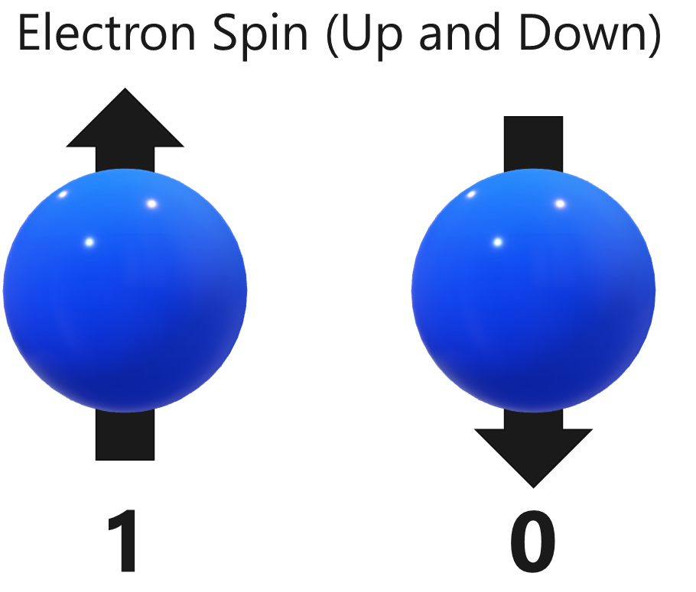
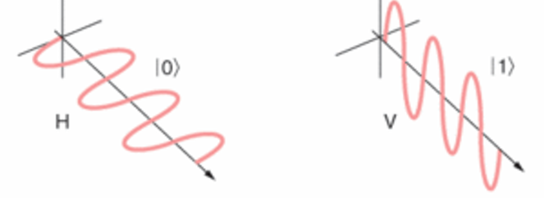
Other Technologies For Qubits
Requirements: Two states + superposition
|1>
|1>
|0>
|1>
|0>
|0>
Electron in an atom
Electron spin(up/down)
Photon polarization (H/V)
Let us use photons to understand the properties of qubits
Notes:
Lecture 2(3)
The state of an electron in an atom is not the only way to encode a qubit. There are several technologies that are being tried to implement qubits. To implement a qubit, we would need at least two stable states and the ability to have matter in the superposition of the two states.
With an electron the position, ground or excited, provides the two states.
For a technology that uses electronic spin to implement the qubit, the upspin may encode a 1 and downspin may encode a zero, and the qubit can be in a superposition of the up or down spin states.

Slide 9
Polarization of Light
Unpolarized (Natural) Light
Horizontally
Polarized Light
Vertically
Polarized Light
Diagonally Polarized Light
❘0〉
❘1〉
❘0〉
❘1〉
and
How do we get polarized light?
Notes:
**An electromagnetic wave such as light consists of a coupled oscillating electric field and magnetic field which are always perpendicular to each other; by convention, the "polarization" of electromagnetic waves refers to the direction of the electric field. So, we have one plane occupied by an electric field, another plane of the magnetic field perpendicular to it, and the direction of travel is perpendicular to both. These electric and magnetic vibrations can occur in numerous planes. A light wave that is vibrating in more than one plane is known as unpolarized light.
Polarized waves are light waves in which the vibrations occur in a single plane. Let us consider only two planes for now- horizontal and vertical. We can think of horizontal direction is state-0 and vertical direction as state-1. If the light is at 45 degree angle then it will be in an equal superposition of state-0 and state-1. We will use photon polarization to further understand the properties of qubits.
Naturally occurring light has electrical waves in all directions. Polarized light is light where the electric field is only oscillating in one direction. (click) It could be horizontally polarized light, or vertically polarized light, or diagonally polarized light. How do we get polarized light?

Slide 10


Polarization Using Filters
We use a polarizing filter, lens or sunglasses.
The filter has an orientation.
The lens filters different types of light.
Filter
Will pass through with 100% probability
Will get blocked with 100% probability
Will pass through with 50% probability
Vertical Lens
Let us use an example
Notes:
You use a polarizing filter or polarizing lens. This is the same type of polarizing lens you have in your polarizing sunglasses.
<click>
What it does is that the lens has a certain orientation, for example, the filter might be vertically oriented. Which means if there is a photon coming through and it is vertically polarized then it goes through. But if it is horizontally polarized then it gets blocked. Thus, it is letting a photon through if it is vertically polarized and blocking if it is horizontally polarized.
But what if the photon was polarized at a diagonal angle 45 degrees, then it will pass through with probability half and will get blocked with probability half. If the photon does pass through, it will get vertically polarized. It does not matter that it was diagonally polarized when it came to the lens, when it is let through it will have the same polarization as the lens.
You can of course change the angle or orientation of this lens and make it a horizontal polarization. In fact, you could tilt the filter to 45 degree and make the lens a diagonal polarization filter such that a diagonally polarized light can pass through with 100% probability and the horizontal or vertical polarization passes through only with 50% probability. Let’s look at an example.

Slide 11
Fun With Polarization
Horizontal Lens
Vertical Lens
(Dark)
Any
Light
All Light
Blocked
HP
Horizontal Lens
Diagonal Lens
Vertical Lens
Any
Light
Partial
Light (25%)
Light/Dark?
HP
DP
Try out some of these experiments for fun ☺
Notes:
Lets say you take two such lenses, the first is oriented horiztontally and the second is oriented vertically and the light from the first lens passes through the second lens.
When normal unpolarized light passes through the first lens, it gets horiztontally polarized and this light gets block by the second lens which is vertically polarized and we do not get any light to pass through.
<click>
What do you think will happen if we add ONE MORE lens in between these two lens. This lens is diagonally polarized. Your gut reaction is would be that light was blocked and you are putting something more to block so if it was dark before it will be even more dark now.
<click>
However, when the horizontally polarized light from the first lens encounters the middle lens it passes through probability half and it ges diagonally polarized. And when this diagonally polarized light hits the vertical lens it can pass through with 50% probability and we get a vertically polarized light so we get a quarter chance of transmission after the first filter. So, we have inserted a lens in the middle and make the light go from 0% probability to 25% probability.
What it does is that the lens has a certain orientation, for example, the filter might be vertically oriented. Which means if there is a photon coming through and it is vertically polarized then it goes through. But if it is horizontally polarized then it gets blocked. Thus, it performing a measurement. Its letting a photon through if it is vertically polarized and blocking if it is horizontally polarized.

Slide 12
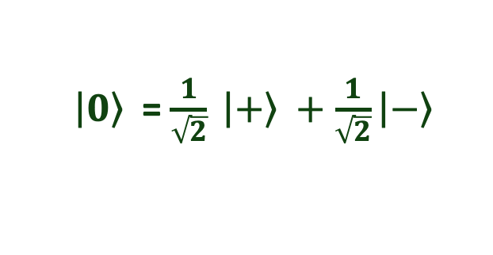
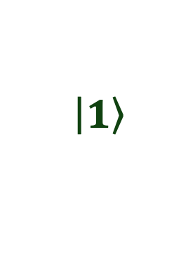
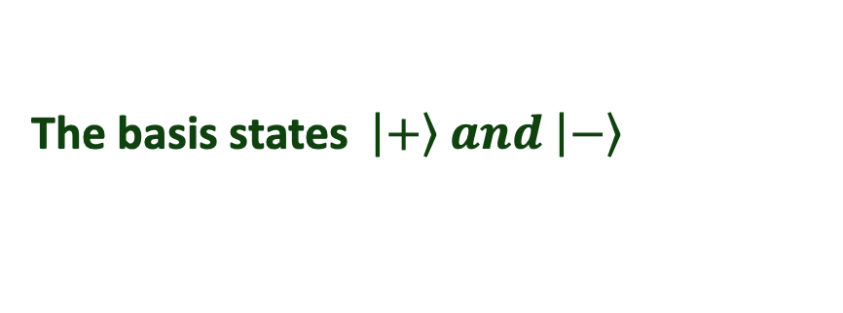
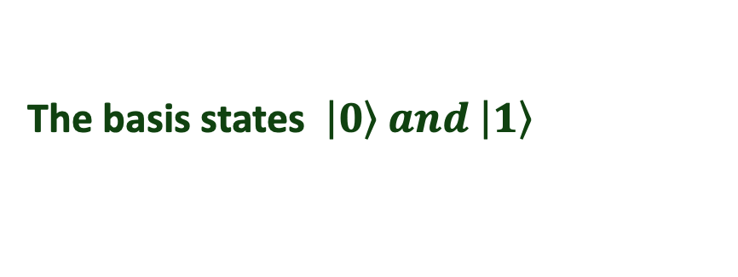
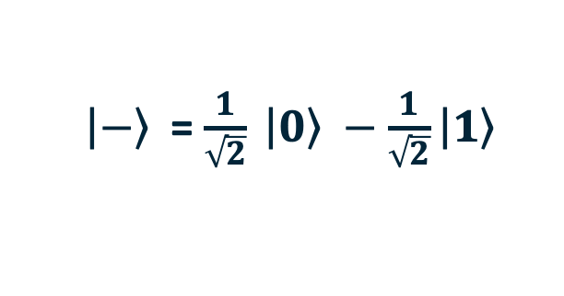

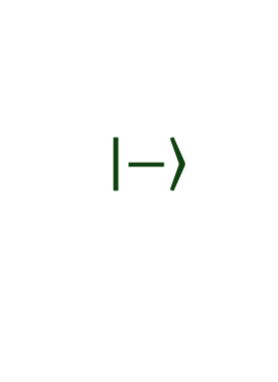
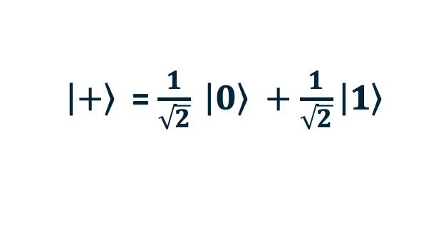
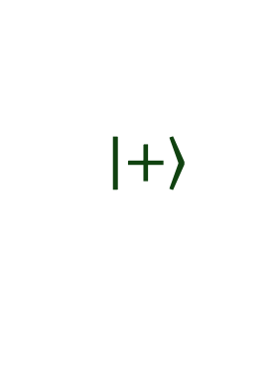
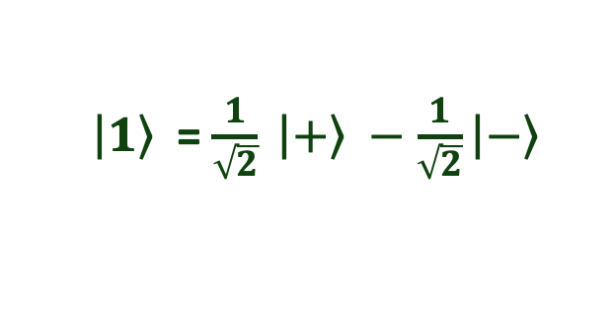
Measurement Using Polarization Filters
Using Vertical/Horizontal Filters
Using Diagonal
Filters
Standard/Computational
Hadamard
$$\left|\left.1\right\rangle \right.$$
$$\left|\left.+\right\rangle \right.$$
The basis states $\left|\left.0\right\rangle and \right.\left|\left.1\right\rangle \right.$
The basis states $\left|\left.+\right\rangle and \right.\left|\left.−\right\rangle \right.$
Hadamard
45
States of Equal Superposition
States of Equal Superposition
$$\left|\left.0\right\rangle \right.$$
$\left|\left.+\right\rangle \right.$= $\frac{1}{\sqrt{2}} \left|\left.0\right\rangle \right.+\frac{1}{\sqrt{2}}\left|\left.1\right\rangle \right.$
$\left|\left.0\right\rangle \right.$= $\frac{1}{\sqrt{2}} \left|\left.+\right\rangle \right.+\frac{1}{\sqrt{2}}\left|\left.−\right\rangle \right.$
$$\left|\left.−\right\rangle \right.$$
$\left|\left.−\right\rangle \right.$= $\frac{1}{\sqrt{2}} \left|\left.0\right\rangle \right.−\frac{1}{\sqrt{2}}\left|\left.1\right\rangle \right.$
$\left|\left.1\right\rangle \right.$= $\frac{1}{\sqrt{2}} \left|\left.+\right\rangle \right.−\frac{1}{\sqrt{2}}\left|\left.−\right\rangle \right.$
Measurement basis is important in quantum computing
Notes:
Lets assume we are using horizontal and vertical polarization filters to perform our measurement. In this case, our basis states will be state-1 for vertical and state-0 for horizontal. When a measurement is made the qubit will collapse to either one of these two states. These set of states are called as the standard or the computational basis states.
<click>
A qubit can be in superposition of the two basis states. For example consider a qubit that is at a diagonal orientation at an angle 45 degrees. This qubit will have equal superposition of the 0 and 1 state. We can call this the + state.
Similarly, a qubit that is at an angle minus 45 degrees will resolve to either 0 or 1 with an equal probability. However, the SIGN for this state will be negative for the “1” state. We call this state as the MINUS state.
Note that the PLUS and MINUS states both have similar magnitude but different sign bit for plus state. Thus, measuring on the standard basis only provides MAGNITUDE but not the SIGN.
We could also perform our measurement with filters that have diagonal polarization. For example, that are oriented at the + and – states. When this mode is used, a measurement is made the qubit will collapse to either the PLUS
Or the MINUS state, revealing the SIGN instead of the MAGNITUDE. This set of basis states are called as HADAMARD basis states.
When we provide a qubit that is in 1 or 0 states and measure it in HADAMARD basis then there is an equal probability of getting either the + or the – state. Thus, 1 or 0 states are in equal superposition of the + and – states.
Whenever we do a measurement we need to specify whether we are doing the measurement in STANDARD or HADAMARD basis. Similarly, to specify superposition, it is important to specify the basis states. Whether the qubit is in superposition or not depends on the basis states. Lets look at some examples.

Slide 13
Superposition = f(Basis States)
Is the qubit in superposition?
y
Theta (degrees) | Standard Basis |0> and |1> | Hadamard Basis |+> and |->
0 | No | Yes
45 | Yes | No
90 | No | Yes
-45 | Yes | No
30 | Yes | Yes
60 | Yes | Yes
θ
x
Superposition depends on the basis states
Notes:
Consider a qubit that is at an angle theta from the horizontal axis. For different values of Theta, specify if the qubit is in superposition in the STANDARD BASIS states.
<click>
For different values of Theta, specify if the qubit is in superposition in the HADAMARD BASIS states.

Slide 14

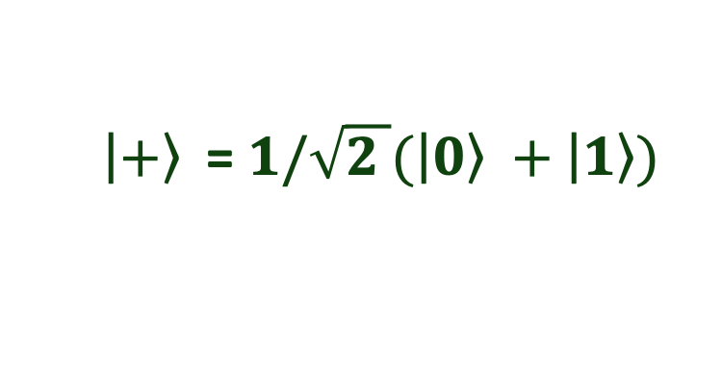
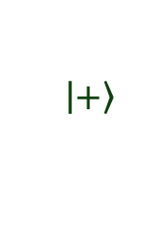

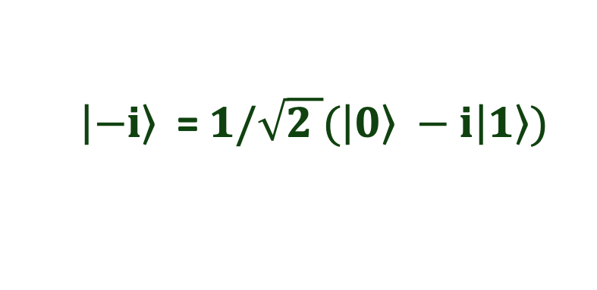

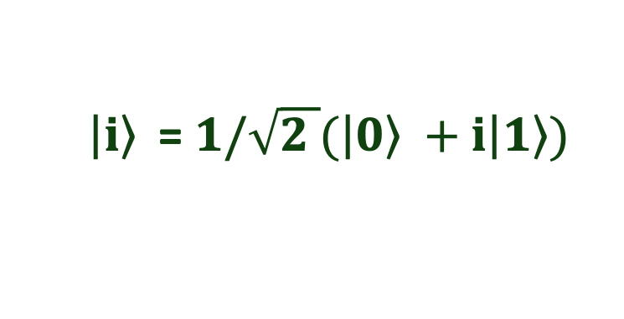

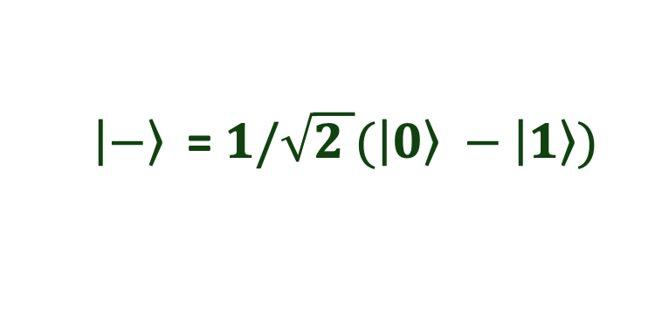

Bloch Sphere Notation
$$\left|\left.1\right\rangle \right.$$
$\left|\left.+\right\rangle \right.$= $1/\sqrt{2 }(\left|\left.0\right\rangle \right.+\left|\left.1\right\rangle )\right.$
$$\left|\left.−\right\rangle \right.$$
$\left|\left.−\right\rangle \right.$= $1/\sqrt{2 }(\left|\left.0\right\rangle \right.−\left|\left.1\right\rangle )\right.$
$$\left|\left.−i\right\rangle \right.$$
$$\left|\left.i\right\rangle \right.$$
$\left|\left.i\right\rangle \right.$= $1/\sqrt{2 }(\left|\left.0\right\rangle \right.+i\left|\left.1\right\rangle )\right.$
$$\left|\left.+\right\rangle \right.$$
$\left|−\left.i\right\rangle \right.$= $1/\sqrt{2 }(\left|\left.0\right\rangle \right.−i\left|\left.1\right\rangle )\right.$
$$0$$
Any point on the Bloch sphere denotes a valid quantum state
Notes:
Consider a qubit that is at an angle theta from the horizontal axis. For different values of Theta, specify if the qubit is in superposition in the STANDARD BASIS states.
<click>
For different values of Theta, specify if the qubit is in superposition in the HADAMARD BASIS states.

Slide 15

Entanglement And Correlated States
Fair Coins
Biased Coins
Biased Coins
Biased Coins
Correlated Coins
Two Fair Coins
Prob_H1 = 50%
Prob_H2 = 50%
Two Biased Coins
Prob_H1 = 80%
Prob_H2 = 30%
Two Biased Coins
Prob_H1 = ??%
Prob_H2 = ??%
Two Coins
Prob_H1 = ??%
Prob_H2 = ??%
60%
25%
State-HH
25%
25%
State-HH
24%
56%
State-HH
15%
45%
State-HH
50%
??
State-HT
State-HT
State-HT
State-HT
State-TH
25%
25%
State-TH
6%
14%
State-TH
??
??
10%
State-TH
??
50%
State-TT
State-TT
State-TT
30%
State-TT
When the two coins are entangled, their outcomes are perfectly correlated

Slide 16
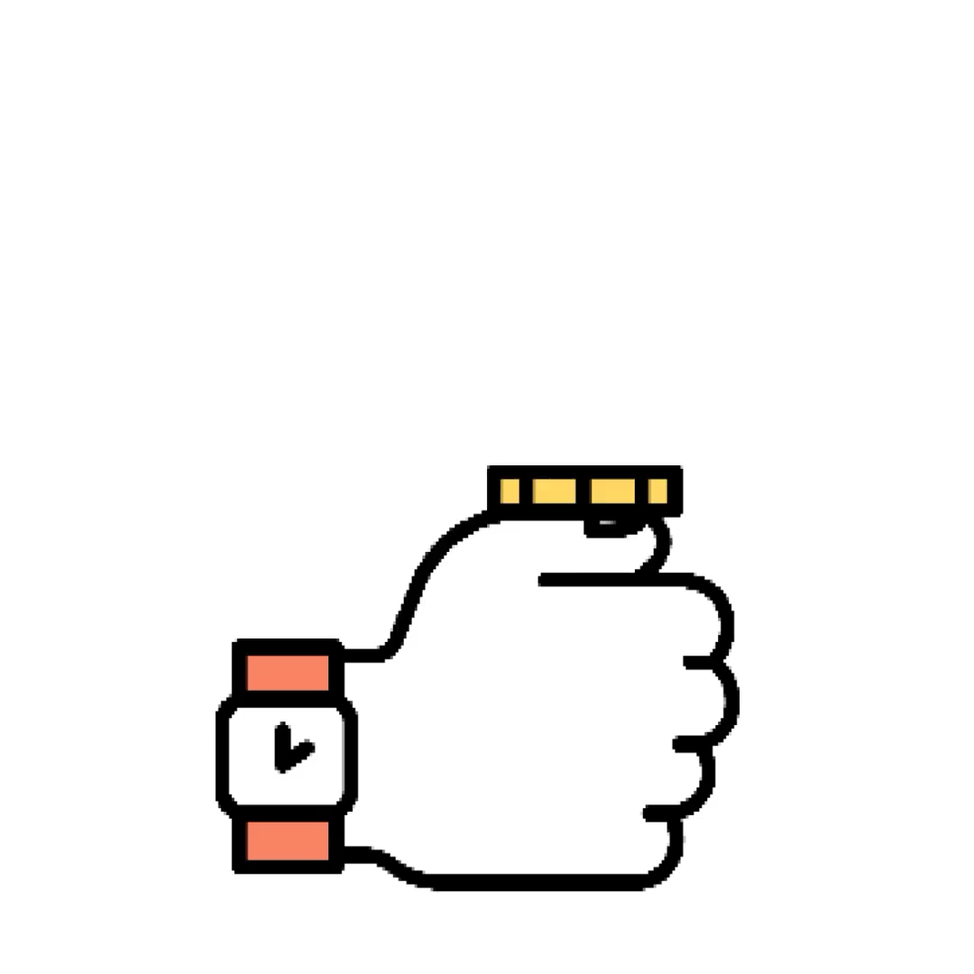
Recollect: Bell Pair Circuit
Quantum programs comprise of quantum operations
1
2
3
4
H
H
Bell pair circuit
q0
H
M
OR
Bell-pair or Entanglement pair
q1
+
M
T
T
1
2
3
The bell-pair is also known as the Einstein-Podolsky-Rosen (EPR) pair

